Slide 1

Welcome

Slide 2
Md. Moazzem Hossain
Lecturer (English)
Dinajpur Balika Alim Madrasah( Nimnogor, Balubari) Sadar Dinajpur
Sub:Eng-1st paper
Class:nine
Dinajpur Balika Alim Madrasah

Slide 3
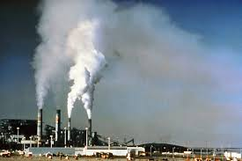
Air pollution

Slide 4
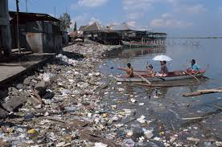
Water pollution

Slide 5
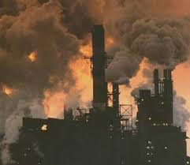
Another example of air pollution

Slide 6
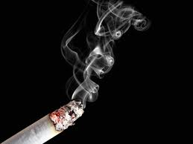
A pollution cause by smoke

Slide 7
Environment pollution

Slide 8
Learning Outcomes:
By the end of the lession the learner will able to….
(i)Tell about environment pollution.
(ii)Identify about the destroying things of environment pollution.
(iii)Write about environment pollution.
(iv)make sentence with new
Words.
(v)ask and answer question.

Slide 9
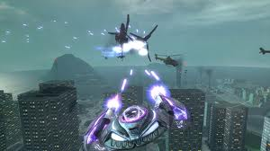
Vocabulary:destroy,waste,environment,pro-blem, clean
Destroy
ruin
We don’t want to destroy

Slide 10
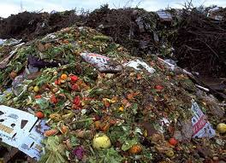
waste
dirty
Our environment is full of waste

Slide 11
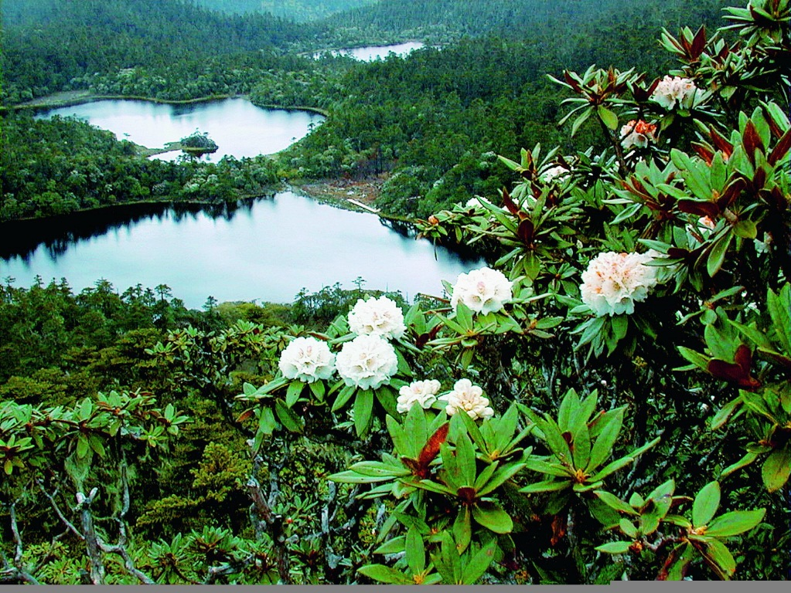
environment
The area of our locality
We want to live in a clear environment

Slide 12
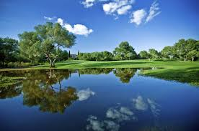
nice
clear
It is a clear environment

Slide 13
True/False
(i)Our environment is full of smoke.
(ii)Dinajpur is free from environment pollution.
(iii)Environment pollution makes our life unpleasant.
(iv)pollution is not caused by fire.
(v)Man makes fire to cook food thus pollutes air
Group Work:
1.
2
.Write a summary with the help of the following words…..
pollution,change ,smoke ,dirty,environment

Slide 14
Evaluation:
What do you know about environment pollution?
What should we do to make our environment neat and clean?

Slide 15

Home work
Write a short paragraph about the “Environment pollution’’ of your locality.

Slide 16

Thanks everybody

